Slide 1
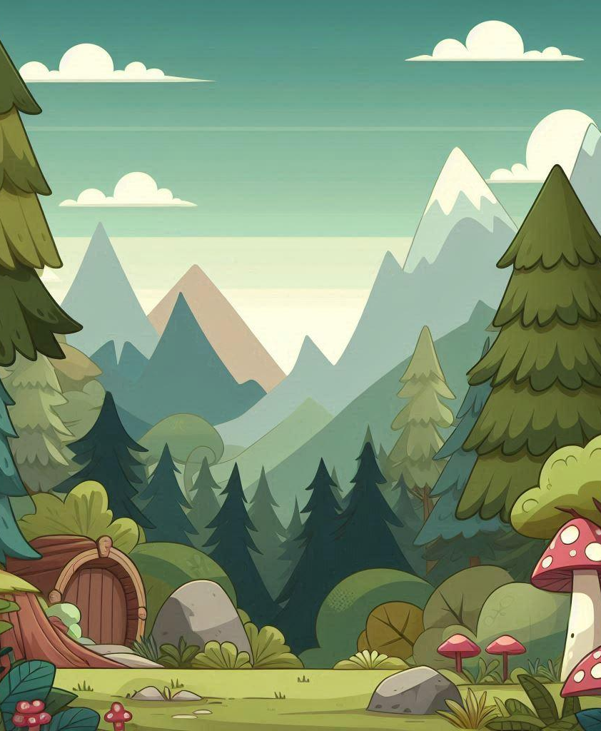
Forest Phonics Capstone Presentation
Matt Foreman,
Candace Cooley,
Benjamin Rand,
Will Schatz

Slide 2
Problem Statement
Problem: Students with dyslexia struggle with reading, spelling, and phonemic awareness.
Why it matters: Traditional methods fail many dyslexic students, causing frustration and disengagement.

Slide 3
Motivation & Objectives
Motivation:
  Address an educational gap for dyslexic students
  Leverage gamification and multi-sensory techniques
Objectives:
  Build an engaging phonics-based game
  Support students, parents, and educators

Slide 4
System Architecture
Physical Layer: UI (Login, Menu, Mini-Games, Dashboard)
Service Layer: Authentication, Game Logic, Progress Tracking
Application Layer: Data Processing, Scoring, Adaptive Learning
Data Layer: User Profiles, Progress, Content Databases

Slide 5
System Modeling & Design Approach
Diagrams:
  Use Case Diagram
  Class Diagram
  Sequence Diagram
  Activity Diagram
Tools:
  Unity Engine
  GitHub for Version Control
  Microsoft Visual Studios for coding
  Discord for meetings and discussions

Slide 6
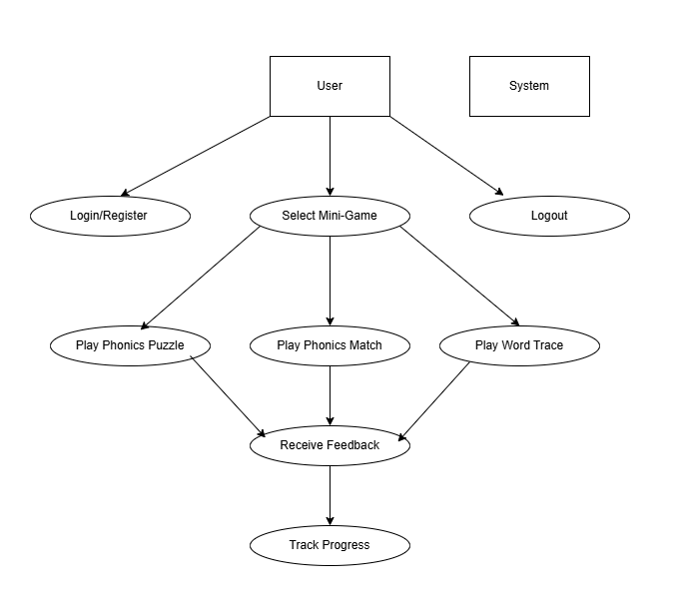
Use Case Diagram
Use Case Diagram:
This diagram shows how the user interacts with Forest Phonics.
Actors:
Student (Primary User)
System (Handles authentication, game logic, and progress tracking)
Use Cases:
Login/Register
Select Mini-Game
Play Mini-Game
  Phonics Puzzles
  Phonics Match
  Word Trace
Receive Feedback
Track Progress
Logout

Slide 7
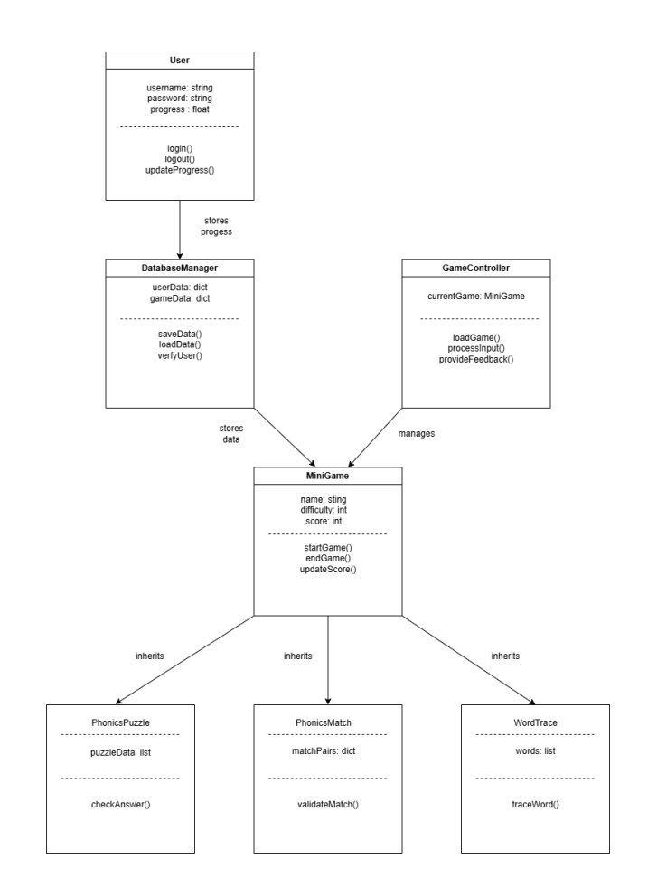
Class Diagram
Key Classes:
User (Attributes: username, password, progress)
MiniGame (Attributes: name, difficulty, score)
PhonicsPuzzle, PhonicsMatch, WordTrace (Inheritance from MiniGame)
DatabaseManager (Handles data storage/retrieval)
GameController (Manages game logic)

Slide 8
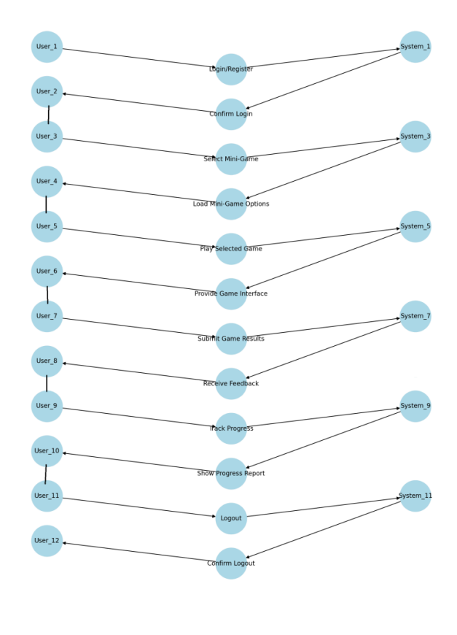
Sequence Diagram
This diagram represents the data flow in the system when a student logs in and plays a mini-game.
Steps:
User inputs login credentials → System verifies from User Database.
User selects a mini-game → System loads game UI.
User interacts with the game → System processes input and checks correctness.
System updates the progress database.
System provides feedback to the user.
User exits the game → System saves the latest progress.

Slide 9
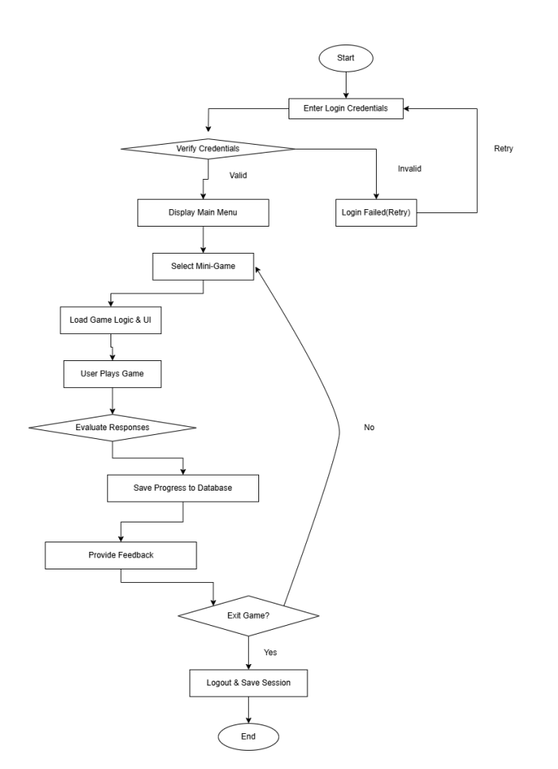
Activity Diagram
Shows the flow of activities in the system.
User opens the game → Login Page.
User logs in → System validates credentials.
User selects a mini-game → System loads the game.
User plays the game → System evaluates responses.
System updates progress → Displays feedback.
User logs out.

Slide 10
Functional Requirements
Achieved Requirements:
Mouse and keyboard
Phoneme matching and word blending
Audio feedback
Progress Tracking
WebGL Implementation
Attempted Requirements:
Progress tracking, badges, and rewards
Letter tracing
Speech recognition
Accessibility settings (fonts, colors)

Slide 11
Non-Functional Requirements
Achieved Requirements:
Fast loading (<6 seconds)
Smooth performance (60 FPS)
High accessibility (dyslexia fonts, TTS)
Secure (PlayFab developer)
Runs WebGL(Unity Play)
Audio Library
Attempted Requirements:
Multi-platform support (browsers, mobile)
Implement Auto-Save
Data Storage

Slide 12
Implementation Highlights
Technologies:
  Unity, WebGL, GitHub, Audacity
Challenges Overcome:
  GitHub branching (pulling, pushing, commits)
  Unity 2D modeling, C# programming
  Finding royalty free audio for each sound

Slide 13
Live Demo / Video Walkthrough
Mini-Games:
  Phonics Puzzles
  Phonics Match
Show:
  Progress Dashboard
  Accessibility Settings

Slide 14
Future Work & Improvements
Implementing score tracking and further interactables for mid-game learning.
Finish adding the Tracing Game
Add additional accessibility
Improve Settings and Background Music
Add larger word bank
Grade level selection
Additional words and sounds

Slide 15
Conclusion
Built a dyslexia-friendly, gamified educational tool
Team building
Github Experience
Unity Game Development

Slide 16
Q&A
Thank you!
We welcome your questions and feedback.

